Slide 1

SOFTWARE ENGINEERING(M23DE0104)
Academic Year:2024-2025, ODD Semester
MCA I Semester, School of CSA
Dr. N. Kavitha
Professor

Slide 2
Unit-iII
Software Modelling and Implementation
Process Planning, Effort Estimation, Project Scheduling and Staffing, Software Configuration Management Plan, Quality Plan, Risk Management, Project Monitoring Plan, Verification, Metrics, Agile Methods, and Agile Development, Extreme Programming, Agile Project Management, Scaling Agile Methods.

Slide 3
Process planning
Process planning in software engineering refers to the systematic organization of tasks, resources, and workflows required to develop software efficiently and effectively. It involves defining the software development lifecycle (SDLC), selecting an appropriate methodology, breaking down tasks, allocating resources, estimating effort, and managing risks.
A well-structured process plan ensures that:
The software is developed on time and within budget.
Resources (human, technical, and financial) are optimally utilized.
Software quality is maintained.
Project risks are minimized.

Slide 4
Importance of Process Planning
Provides a structured approach to software development.
Helps in resource allocation and cost estimation.
Enhances project tracking and risk management.
Ensures software quality by defining testing and validation stages.
Reduces development time through effective scheduling.

Slide 5
Key Steps in Process Planning
Requirement Analysis
Selection of Software Development Model
Understanding functional and non-functional requirements.
Identifying stakeholder needs.
Preparing a Software Requirements Specification (SRS) document.
Choosing an appropriate software development methodology based on project scope, complexity, and requirements:
  Waterfall Model – Best for well-defined projects.
  Agile Model – Ideal for iterative development.
  Spiral Model – Suitable for risk-prone projects.
Task Breakdown & Work Breakdown Structure (WBS)
Dividing the project into smaller, manageable tasks.
Assigning responsibilities to development teams.
Scheduling & Timeline Management
Defining milestones and deadlines.
Using Gantt Charts, PERT (Program Evaluation and Review Technique), or Critical Path Method (CPM) for scheduling.

Slide 6
Resource Allocation
Assigning team members to different tasks.
Managing software and hardware resources.
Estimating budget and effort required for each phase.
Risk Management & Contingency Planning
Identifying potential risks (e.g., technical failures, budget overruns).
Creating contingency plans to handle uncertainties.
Quality Assurance and Testing Strategy
Defining testing methodologies (unit testing, integration testing, system testing, acceptance testing).
Ensuring compliance with industry standards (ISO, IEEE, CMMI).
Implementing code reviews and automated testing tools.
Process Documentation
Creating technical documentation for future reference.
Maintaining version control using Git, SVN, or Bitbucket.

Slide 7
Monitoring & Continuous Improvement
Tracking project progress using tools like JIRA, Trello, or MS Project.
Conducting regular sprint reviews (Agile) or phase reviews (Waterfall).
Implementing feedback loops for process optimization.

Slide 8
Effort Estimation

Slide 9
What is effort estimation?
Effort estimation is the process of forecasting how much effort is required to develop or maintain a software application. This effort is traditionally measured in the hours worked by a person, or the money needed to pay for this work.
Playing a significant role in setting realistic timelines and allocating resources efficiently
Effort in software estimation refers to the total amount of work required to complete a project, typically measured in Person-Months (PM) or Person-Hours (PH). It represents the workload needed to develop, test, document, and deliver the software.
Development time (also called Duration) refers to the total calendar time required to complete the software project, usually measured in months.

Slide 10
Different approaches for effort estimation
Expert Judgment (based on past experience)-Heuristic-Based Approaches
COCOMO (Constructive Cost Model) (using mathematical formulas)-Algorithmic-Based Approaches
Function Point Analysis (FPA) (estimating effort based on system functionalities)-Algorithmic-Based Approaches
Analogy-Based Estimation-Empirical & Data-Driven Approaches
Compares the current project with past similar projects to derive estimates.
Works well when historical project data is available.

Slide 11
Software Cost Estimation
Common Methods of Software Cost Estimation:
Expert Judgment: Estimation based on the experience of professionals who have worked on similar projects. Example: A senior developer may estimate the cost based on their prior experience with similar projects.
Analogy-Based Estimation: Comparing the current project to similar completed projects to estimate the cost. Example: Estimating the cost based on a previous project that had similar features and scope.
Algorithmic Estimation Models: Using mathematical formulas to estimate cost based on factors like project size, complexity, and effort.
Example: Using models like COCOMO (Constructive Cost Model) or Function Point Analysis to estimate cost.
Wideband Delphi Method: A group of experts provides estimates and discusses them to arrive at a consensus. Example: A team of developers and project managers work together to give cost estimates, and then refine them based on group discussions.

Slide 12
Expert judgment
Expert judgment is a software effort estimation technique where experienced professionals provide estimates based on their past projects, domain knowledge, and intuition. It is widely used due to its simplicity and effectiveness, especially in the early stages of a project.
How Expert Judgment Works?
Gather Experts – Select experienced developers, project managers, and domain specialists.
Define Requirements – Provide a clear understanding of project scope, objectives, and constraints.
Estimate Effort – Experts provide estimates based on their past experiences.
Compare & Adjust – Experts discuss their estimates, refine them based on additional insights, and reach a consensus.

Slide 13
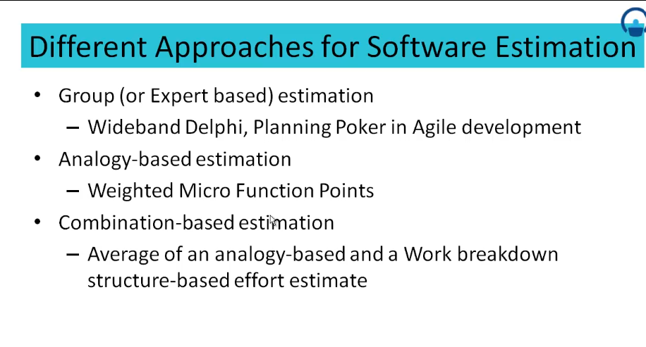

Slide 14
The Constructive Cost Model (COCOMO)
Constructive Cost model
(COCOMO)
Basic Intermediate Detailed
Model proposed by
B. W. Boehm’s through his book
Software Engineering Economics in 1981

Slide 15
Estimation Method: COCOMO/ Model
COCOMO applied to
Semidetached mode
Organic mode
Embedded mode
COCOMO is an empirical model used for software cost estimation.

Slide 16
Software Project Planning
Mode | Project size | Nature of Project | Innovation | Deadline of the project | Development Environment
Organic | Typically 2-50 KLOC | Small size project, experienced developers in the familiar environment. For example, pay roll, inventory projects etc. | Little | Not tight | Familiar & In house
Semi detached | Typically 50-300 KLOC | Medium size project, Medium size team, Average previous experience on similar project. For example: Utility systems like compilers, database systems, editors etc. | Medium | Medium | Medium
Embedded | Typically over 300 KLOC | Large project, Real time systems, Complex interfaces, Very little previous experience. For example: ATMs, Air Traffic Control etc. | Significant | Tight | Complex Hardware/ customer Interfaces required
Table 4: The comparison of three COCOMO modes

Slide 17
Software Project Planning
Basic Model
Basic COCOMO model takes the form
E = a (KLOC)
b
b
b
D = c (E)
d
b
b
where E is effort applied in Person-Months, and D is the development time in
months. The coefficients a_{b}, b_{b}, c_{b} and d_{b} are given in table 4 (a).

Slide 18
Software Project Planning
Software Project | a_{b} | b_{b} | c_{b} | d_{b}
Organic | 2.4 | 1.05 | 2.5 | 0.38
Semidetached | 3.0 | 1.12 | 2.5 | 0.35
Embedded | 3.6 | 1.20 | 2.5 | 0.32
Table 4(a): Basic COCOMO coefficients

Slide 19
Software Project Planning
When effort and development time are known, the average staff size to complete the project may be calculated as:
Average staff size
(SS) = ^{E} Persons
D
When project size is known, the productivity level may be calculated as:
Productivity
(P) = ^{KLOC} KLOC / PM
E

Slide 20
Software Project Planning
Example: 4.5
Suppose that a project was estimated to be 400 KLOC. Calculate the effort and development time for each of the three modes i.e., organic, semidetached and embedded.

Slide 21
Software Project Planning
Solution
The basic COCOMO equation take the form:
E = a (KLOC)
b
b
b
D = c (KLOC)
d
b
b
Estimated size of the project = 400 KLOC
(i) Organic mode
E = 2.4(400)^{1.05} = 1295.31 PM
D = 2.5(1295.31)^{0.38} = 38.07 PM

Slide 22
Software Project Planning
(ii) Semidetached mode
E = 3.0(400)^{1.12} = 2462.79 PM
D = 2.5(2462.79)^{0.35} = 38.45 PM
(iii) Embedded mode
E = 3.6(400)^{1.20} = 4772.81 PM
D = 2.5(4772.8)^{0.32} = 38 PM

Slide 23
Software Project Planning
Example: 4.6
A project size of 200 KLOC is to be developed. Software development team has average experience on similar type of projects. The project schedule is not very tight. Calculate the effort, development time, average staff size and productivity of the project.

Slide 24
Software Project Planning
Solution
The semi-detached mode is the most appropriate mode; keeping in view the size,
schedule and experience of the development team.
Hence
E = 3.0(200)^{1.12} = 1133.12 PM
D = 2.5(1133.12)^{0.35} = 29.3 PM
Average staff size
(SS) = ^{E} Persons
D
= ^{1133.12} = 38.67Persons
29.3

Slide 25
Software Project Planning
₌ KLOC ₌ 200
Productivity
= 0.1765 KLOC / PM
E 1133.12
P = 176 LOC / PM

Slide 26
Analogy-Based Estimation
Analogy-based estimation is a comparative estimation technique that predicts effort, cost, or time for a new project by comparing it to similar past projects.
How It Works?
Identify a Similar Past Project
  Look at completed projects with comparable scope, complexity, and technology.
Extract Key Attributes
  Analyze effort, duration, team size, and productivity factors.
Compare and Adjust
  Adjust for differences in size, technology, team experience, and other project-specific factors.

Slide 27
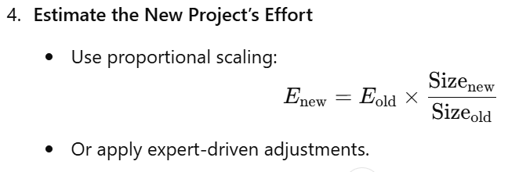
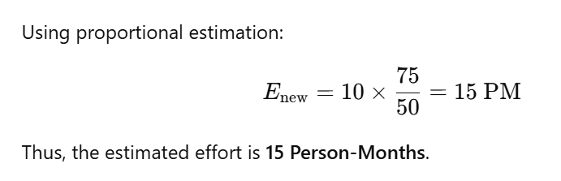
Estimated Size: 75 KLOC
Example Calculation
New Project:
Size: 50 KLOC
Effort: 10 Person-Months

Slide 28
Project Scheduling and Staffing

Slide 29
Project Scheduling and Staffing
Project scheduling involves outlining tasks, timelines, and resources needed to complete a project efficiently.
Staffing refers to assigning the right personnel to these tasks based on their skills and availability.
Effective project scheduling and staffing are crucial for meeting deadlines, maintaining budgets, and ensuring project success.
It's important to regularly review and update both scheduling and staffing plans as projects evolve.

Slide 30
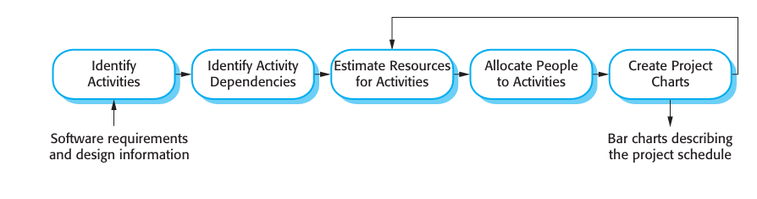
Scheduling in project management means to list out activities, deliverables, and milestones within a project that are delivered.
It contains more notes than your average weekly planner notes.
The most common and important form of project schedule is Gantt chart.

Slide 31
The manager needs to estimate time and resources of project while scheduling project.
All activities in project must be arranged in a coherent sequence that means activities should be arranged in a logical and well-organized manner for easy to understand.
Initial estimates of project can be made optimistically which means estimates can be made when all favorable things will happen and no threats or problems take place.

Slide 32
The total work is separated or divided into various small activities or tasks during project schedule.
Then, Project manager will decide time required for each activity or task to get completed. Even some activities are conducted and performed in parallel for efficient performance.
The project schedule is represented as set of chart in which work-breakdown structure and dependencies within various activities are represented.
To accomplish and complete project within a given schedule, required resources must be available when they are needed. Therefore, resource estimation should be done before starting development.

Slide 33
Resources required for Development of Project :
Human effort
Sufficient disk space on server
Specialized hardware
Software technology
Travel allowance required by project staff, etc.

Slide 34
Advantages of Project Scheduling :
There are several advantages provided by project schedule in our project management:
It simply ensures that everyone remains on same page as far as tasks get completed, dependencies, and deadlines.
It helps in identifying issues early and concerns such as lack or unavailability of resources.
It also helps to identify relationships and to monitor process.
It provides effective budget management and risk mitigation.

Slide 35
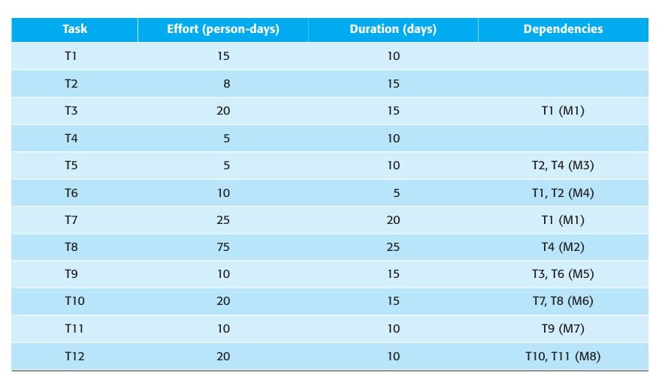

Slide 36
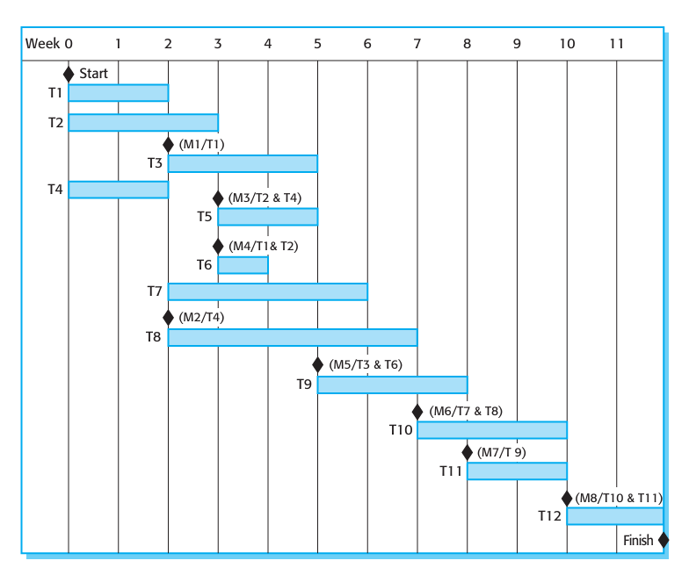

Slide 37
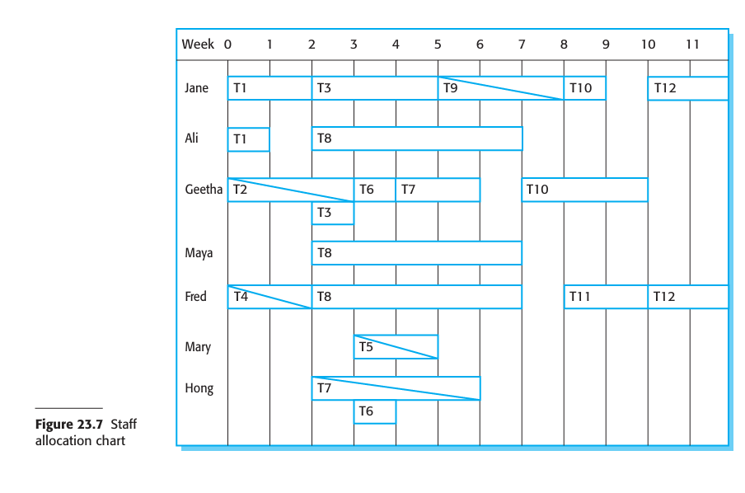

Slide 38
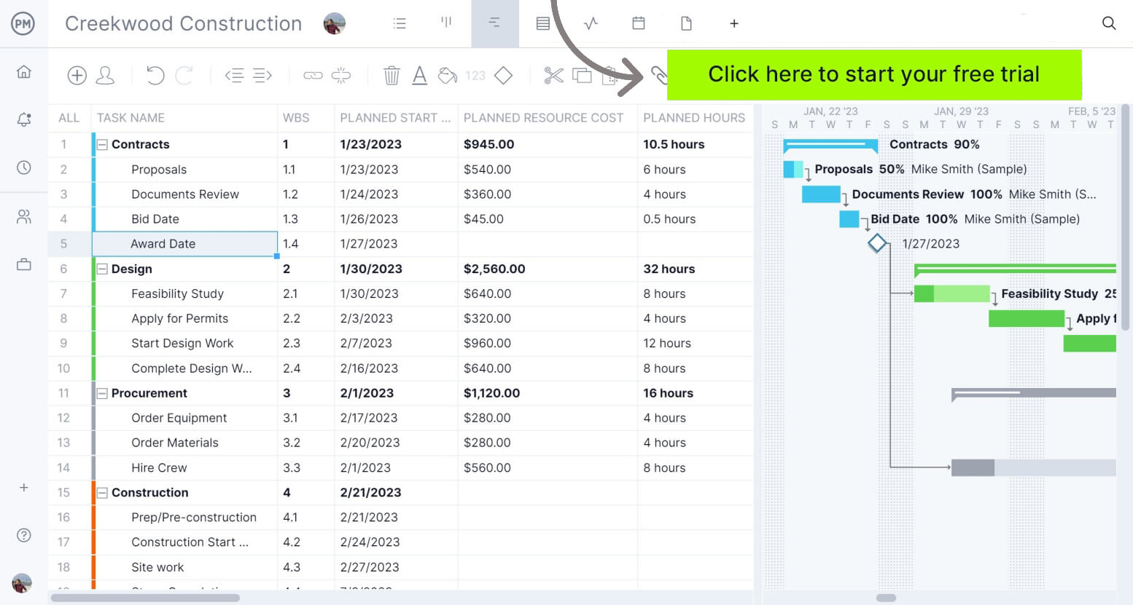

Slide 39
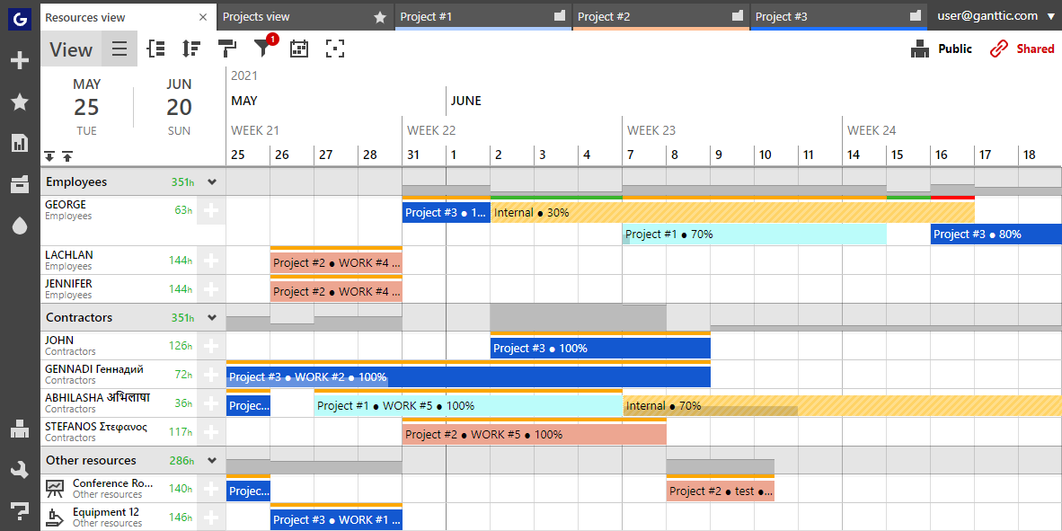

Slide 40
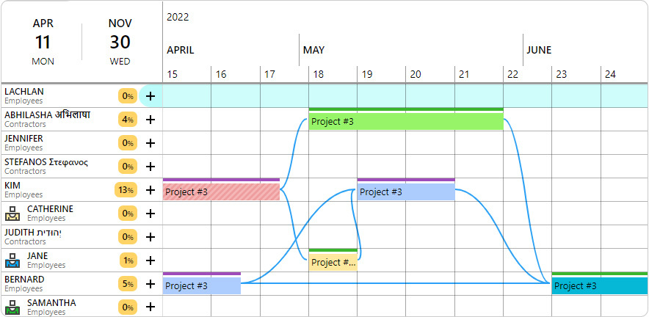

Slide 41
Software Configuration Management Plan

Slide 42
Software Configuration Management Plan
What is Software Configuration Management?
Software Configuration Management(SCM) is a process to systematically manage, organize, and control the changes in the documents, codes, and other entities during the Software Development Life Cycle.
The primary goal is to increase productivity with minimal mistakes.
SCM is part of cross-disciplinary field of configuration management and it can accurately determine who made which revision.

Slide 43
Key Objectives of SCM:
Change Control: Ensures that modifications to the software are reviewed, approved, and implemented in a structured manner.
Version Control: Maintains different versions of software to prevent conflicts and track modifications over time.
Configuration Identification: Identifies software components that need to be managed under SCM, such as source code, documents, and test cases.
Configuration Status Accounting: Keeps detailed records of changes, including when and by whom they were made.
Configuration Audits: Periodic evaluations to ensure that the software adheres to specified requirements and standards.

Slide 44
Why is SCM Important?
SCM enhances software quality, improves collaboration among development teams, and reduces risks associated with software changes. It also enables organizations to accurately determine who made a specific revision, what changes were made, and why.
Why do we need Configuration management?
The primary reasons for Implementing Technical Software Configuration Management System are:
There are multiple people working on software which is continually updating
It may be a case where multiple version, branches, authors are involved in a software config project, and the team is geographically distributed and works concurrently
Changes in user requirement, policy, budget, schedule need to be accommodated.
Software should able to run on various machines and Operating Systems
Helps to develop coordination among stakeholders
SCM process is also beneficial to control the costs involved in making changes to a system

Slide 45
Software Configuration Management Plan
The SCMP (Software Configuration management planning) process planning begins at the early coding phases of a project. The outcome of the planning phase is the SCM plan which might be stretched or revised during the project.
The SCMP can follow a public standard like the IEEE 828 or organization specific standard
It defines the types of documents to be management and a document naming. Example Test_v1
SCMP defines the person who will be responsible for the entire SCM process and creation of baselines.
Fix policies for version management & change control
Define tools which can be used during the SCM process
Configuration management database for recording configuration information.

Slide 46
Quality plan

Slide 47
Software quality management
Concerned with ensuring that the required level of quality is achieved in a software product.
Three principal concerns:
  At the organizational level, quality management is concerned with establishing a framework of organizational processes and standards that will lead to high-quality software.
  At the project level, quality management involves the application of specific quality processes and checking that these planned processes have been followed.
  At the project level, quality management is also concerned with establishing a quality plan for a project. The quality plan should set out the quality goals for the project and define what processes and standards are to be used.

Slide 48
Quality management activities
Quality management provides an independent check on the software development process.
The quality management process checks the project deliverables to ensure that they are consistent with organizational standards and goals
The quality team should be independent from the development team so that they can take an objective view of the software. This allows them to report on software quality without being influenced by software development issues.

Slide 49
Quality management and software development

Slide 50
Quality planning
A quality plan sets out the desired product qualities and how these are assessed and defines the most significant quality attributes.
The quality plan should define the quality assessment process.
It should set out which organisational standards should be applied and, where necessary, define new standards to be used.

Slide 51
Quality plans
Quality plan structure
  Product introduction;
  Product plans;
  Process descriptions;
  Quality goals;
  Risks and risk management.
Quality plans should be short, succinct documents
  If they are too long, no-one will read them.

Slide 52
Scope of quality management
Quality management is particularly important for large, complex systems. The quality documentation is a record of progress and supports continuity of development as the development team changes.
For smaller systems, quality management needs less documentation and should focus on establishing a quality culture.
Techniques have to evolve when agile development is used.

Slide 53
Risk management

Slide 54
Risk management
Risk management is concerned with identifying risks and drawing up plans to minimise their effect on a project.
Software risk management is important because of the inherent uncertainties in software development.
  These uncertainties stem from loosely defined requirements, requirements changes due to changes in customer needs, difficulties in estimating the time and resources required for software development, and differences in individual skills.
You have to anticipate risks, understand the impact of these risks on the project, the product and the business, and take steps to avoid these risks.

Slide 55
Risk classification
There are two dimensions of risk classification
  The type of risk (technical, organizational, ..)
  what is affected by the risk:
Project risks affect schedule or resources;
Product risks affect the quality or performance of the software being developed;
Business risks affect the organisation developing or procuring the software.

Slide 56
Examples of project, product, and business risks
Risk | Affects | Description
Staff turnover | Project | Experienced staff will leave the project before it is finished.
Management change | Project | There will be a change of organizational management with different priorities.
Hardware unavailability | Project | Hardware that is essential for the project will not be delivered on schedule.
Requirements change | Project and product | There will be a larger number of changes to the requirements than anticipated.
Specification delays | Project and product | Specifications of essential interfaces are not available on schedule.
Size underestimate | Project and product | The size of the system has been underestimated.
CASE tool underperformance | Product | CASE tools, which support the project, do not perform as anticipated.
Technology change | Business | The underlying technology on which the system is built is superseded by new technology.
Product competition | Business | A competitive product is marketed before the system is completed.

Slide 57
The risk management process
Risk identification
  Identify project, product and business risks;
Risk analysis
  Assess the likelihood and consequences of these risks;
Risk planning
  Draw up plans to avoid or minimise the effects of the risk;
Risk monitoring
  Monitor the risks throughout the project;

Slide 58
The risk management process

Slide 59
Risk identification
May be a team activities or based on the individual project manager’s experience.
A checklist of common risks may be used to identify risks in a project
  Technology risks.
  Organizational risks.
  People risks.
  Requirements risks.
  Estimation risks.

Slide 60
Examples of different risk types
Risk type | Possible risks
Estimation | The time required to develop the software is underestimated. (12) The rate of defect repair is underestimated. (13) The size of the software is underestimated. (14)
Organizational | The organization is restructured so that different management are responsible for the project. (6) Organizational financial problems force reductions in the project budget. (7)
People | It is impossible to recruit staff with the skills required. (3) Key staff are ill and unavailable at critical times. (4) Required training for staff is not available. (5)
Requirements | Changes to requirements that require major design rework are proposed. (10) Customers fail to understand the impact of requirements changes. (11)
Technology | The database used in the system cannot process as many transactions per second as expected. (1) Reusable software components contain defects that mean they cannot be reused as planned. (2)
Tools | The code generated by software code generation tools is inefficient. (8) Software tools cannot work together in an integrated way. (9)

Slide 61
Risk analysis
Assess probability and seriousness of each risk.
Probability may be very low, low, moderate, high or very high.
Risk consequences might be catastrophic, serious, tolerable or insignificant.

Slide 62
Risk types and examples
Risk | Probability | Effects
Organizational financial problems force reductions in the project budget (7). | Low | Catastrophic
It is impossible to recruit staff with the skills required for the project (3). | High | Catastrophic
Key staff are ill at critical times in the project (4). | Moderate | Serious
Faults in reusable software components have to be repaired before these components are reused. (2). | Moderate | Serious
Changes to requirements that require major design rework are proposed (10). | Moderate | Serious
The organization is restructured so that different management are responsible for the project (6). | High | Serious
The database used in the system cannot process as many transactions per second as expected (1). | Moderate | Serious

Slide 63
Risk types and examples
Risk9 | Probability | Effects
The time required to develop the software is underestimated (12). | High | Serious
Software tools cannot be integrated (9). | High | Tolerable
Customers fail to understand the impact of requirements changes (11). | Moderate | Tolerable
Required training for staff is not available (5). | Moderate | Tolerable
The rate of defect repair is underestimated (13). | Moderate | Tolerable
The size of the software is underestimated (14). | High | Tolerable
Code generated by code generation tools is inefficient (8). | Moderate | Insignificant

Slide 64
Risk planning
Consider each risk and develop a strategy to manage that risk.
Avoidance strategies
  The probability that the risk will arise is reduced;
Minimization strategies
  The impact of the risk on the project or product will be reduced;
Contingency plans
  If the risk arises, contingency plans are plans to deal with that risk;

Slide 65
What-if questions
What if several engineers are ill at the same time?
What if an economic downturn leads to budget cuts of 20% for the project?
What if the performance of open-source software is inadequate and the only expert on that open source software leaves?
What if the company that supplies and maintains software components goes out of business?
What if the customer fails to deliver the revised requirements as predicted?

Slide 66
Strategies to help manage risk
Risk | Strategy
Organizational financial problems | Prepare a briefing document for senior management showing how the project is making a very important contribution to the goals of the business and presenting reasons why cuts to the project budget would not be cost-effective.
Recruitment problems | Alert customer to potential difficulties and the possibility of delays; investigate buying-in components.
Staff illness | Reorganize team so that there is more overlap of work and people therefore understand each other’s jobs.
Defective components | Replace potentially defective components with bought-in components of known reliability.
Requirements changes | Derive traceability information to assess requirements change impact; maximize information hiding in the design.

Slide 67
Strategies to help manage risk
Risk | Strategy
Organizational restructuring | Prepare a briefing document for senior management showing how the project is making a very important contribution to the goals of the business.
Database performance | Investigate the possibility of buying a higher-performance database.
Underestimated development time | Investigate buying-in components; investigate use of a program generator.

Slide 68
Risk monitoring
Assess each identified risks regularly to decide whether or not it is becoming less or more probable.
Also assess whether the effects of the risk have changed.
Each key risk should be discussed at management progress meetings.

Slide 69
Risk indicators
Risk type | Potential indicators
Estimation | Failure to meet agreed schedule; failure to clear reported defects.
Organizational | Organizational gossip; lack of action by senior management.
People | Poor staff morale; poor relationships amongst team members; high staff turnover.
Requirements | Many requirements change requests; customer complaints.
Technology | Late delivery of hardware or support software; many reported technology problems.
Tools | Reluctance by team members to use tools; complaints about CASE tools; demands for higher-powered workstations.

Slide 70
Agile Software Development

Slide 71
Topics covered
Agile methods
Agile development techniques
Agile project management
Scaling agile methods

Slide 72
Rapid software development
Rapid development and delivery is now often the most important requirement for software systems
  Businesses operate in a fast –changing requirement and it is practically impossible to produce a set of stable software requirements
  Software has to evolve quickly to reflect changing business needs.
Plan-driven development is essential for some types of system but does not meet these business needs.
Agile development methods emerged in the late 1990s whose aim was to radically reduce the delivery time for working software systems

Slide 73
Agile development
Program specification, design and implementation are inter-leaved
The system is developed as a series of versions or increments with stakeholders involved in version specification and evaluation
Frequent delivery of new versions for evaluation
Extensive tool support (e.g. automated testing tools) used to support development.
Minimal documentation – focus on working code

Slide 74
Plan-driven and agile development

Slide 75
Plan-driven and agile development
Plan-driven development
  A plan-driven approach to software engineering is based around separate development stages with the outputs to be produced at each of these stages planned in advance.
  Not necessarily waterfall model – plan-driven, incremental development is possible
  Iteration occurs within activities.
Agile development
  Specification, design, implementation and testing are inter-leaved and the outputs from the development process are decided through a process of negotiation during the software development process.

Slide 76
Agile methods

Slide 77
Agile methods
Dissatisfaction with the overheads involved in software design methods of the 1980s and 1990s led to the creation of agile methods. These methods:
  Focus on the code rather than the design
  Are based on an iterative approach to software development
  Are intended to deliver working software quickly and evolve this quickly to meet changing requirements.
The aim of agile methods is to reduce overheads in the software process (e.g. by limiting documentation) and to be able to respond quickly to changing requirements without excessive rework.

Slide 78
Agile manifesto
We are uncovering better ways of developing software by doing it and helping others do it. Through this work we have come to value:
  Individuals and interactions over processes and tools
  Working software over comprehensive documentation
  Customer collaboration over contract negotiation
  Responding to change over following a plan
That is, while there is value in the items on the right, we value the items on the left more.

Slide 79
The principles of agile methods
Principle | Description
Customer involvement | Customers should be closely involved throughout the development process. Their role is provide and prioritize new system requirements and to evaluate the iterations of the system.
Incremental delivery | The software is developed in increments with the customer specifying the requirements to be included in each increment.
People not process | The skills of the development team should be recognized and exploited. Team members should be left to develop their own ways of working without prescriptive processes.
Embrace change | Expect the system requirements to change and so design the system to accommodate these changes.
Maintain simplicity | Focus on simplicity in both the software being developed and in the development process. Wherever possible, actively work to eliminate complexity from the system.

Slide 80
Agile method applicability
Product development where a software company is developing a small or medium-sized product for sale.
  Virtually all software products and apps are now developed using an agile approach
Custom system development within an organization, where there is a clear commitment from the customer to become involved in the development process and where there are few external rules and regulations that affect the software.

Slide 81
Agile development techniques

Slide 82
Extreme programming
A very influential agile method, developed in the late 1990s, that introduced a range of agile development techniques.
Extreme Programming (XP) takes an ‘extreme’ approach to iterative development.
  New versions may be built several times per day;
  Increments are delivered to customers every 2 weeks;
  All tests must be run for every build and the build is only accepted if tests run successfully.

Slide 83
The extreme programming release cycle

Slide 84
Extreme programming practices (a)
Principle or practice | Description
Incremental planning | Requirements are recorded on story cards and the stories to be included in a release are determined by the time available and their relative priority. The developers break these stories into development ‘Tasks’. See Figures 3.5 and 3.6.
Small releases | The minimal useful set of functionality that provides business value is developed first. Releases of the system are frequent and incrementally add functionality to the first release.
Simple design | Enough design is carried out to meet the current requirements and no more.
Test-first development | An automated unit test framework is used to write tests for a new piece of functionality before that functionality itself is implemented.
Refactoring | All developers are expected to refactor the code continuously as soon as possible code improvements are found. This keeps the code simple and maintainable.

Slide 85
Extreme programming practices (b)
Pair programming | Developers work in pairs, checking each other’s work and providing the support to always do a good job.
Collective ownership | The pairs of developers work on all areas of the system, so that no islands of expertise develop and all the developers take responsibility for all of the code. Anyone can change anything.
Continuous integration | As soon as the work on a task is complete, it is integrated into the whole system. After any such integration, all the unit tests in the system must pass.
Sustainable pace | Large amounts of overtime are not considered acceptable as the net effect is often to reduce code quality and medium term productivity
On-site customer | A representative of the end-user of the system (the customer) should be available full time for the use of the XP team. In an extreme programming process, the customer is a member of the development team and is responsible for bringing system requirements to the team for implementation.

Slide 86
XP and agile principles
Incremental development is supported through small, frequent system releases.
Customer involvement means full-time customer engagement with the team.
People not process through pair programming, collective ownership and a process that avoids long working hours.
Change supported through regular system releases.
Maintaining simplicity through constant refactoring of code.

Slide 87
Influential XP practices
Extreme programming has a technical focus and is not easy to integrate with management practice in most organizations.
Consequently, while agile development uses practices from XP, the method as originally defined is not widely used.
Key practices
  User stories for specification
  Refactoring
  Test-first development
  Pair programming

Slide 88
User stories for requirements
In XP, a customer or user is part of the XP team and is responsible for making decisions on requirements.
User requirements are expressed as user stories or scenarios.
These are written on cards and the development team break them down into implementation tasks. These tasks are the basis of schedule and cost estimates.
The customer chooses the stories for inclusion in the next release based on their priorities and the schedule estimates.

Slide 89
A ‘prescribing medication’ story

Slide 90
Examples of task cards for prescribing medication

Slide 91
Refactoring
Conventional wisdom in software engineering is to design for change. It is worth spending time and effort anticipating changes as this reduces costs later in the life cycle.
XP, however, maintains that this is not worthwhile as changes cannot be reliably anticipated.
Rather, it proposes constant code improvement (refactoring) to make changes easier when they have to be implemented.

Slide 92
Refactoring
Programming team look for possible software improvements and make these improvements even where there is no immediate need for them.
This improves the understandability of the software and so reduces the need for documentation.
Changes are easier to make because the code is well-structured and clear.
However, some changes requires architecture refactoring and this is much more expensive.

Slide 93
Examples of refactoring
Re-organization of a class hierarchy to remove duplicate code.
Tidying up and renaming attributes and methods to make them easier to understand.
The replacement of inline code with calls to methods that have been included in a program library.

Slide 94
Test-first development
Testing is central to XP and XP has developed an approach where the program is tested after every change has been made.
XP testing features:
  Test-first development.
  Incremental test development from scenarios.
  User involvement in test development and validation.
  Automated test harnesses are used to run all component tests each time that a new release is built.

Slide 95
Test-driven development
Writing tests before code clarifies the requirements to be implemented.
Tests are written as programs rather than data so that they can be executed automatically. The test includes a check that it has executed correctly.
  Usually relies on a testing framework such as Junit.
All previous and new tests are run automatically when new functionality is added, thus checking that the new functionality has not introduced errors.

Slide 96
Customer involvement
The role of the customer in the testing process is to help develop acceptance tests for the stories that are to be implemented in the next release of the system.
The customer who is part of the team writes tests as development proceeds. All new code is therefore validated to ensure that it is what the customer needs.
However, people adopting the customer role have limited time available and so cannot work full-time with the development team. They may feel that providing the requirements was enough of a contribution and so may be reluctant to get involved in the testing process.

Slide 97
Test case description for dose checking

Slide 98
Test automation
Test automation means that tests are written as executable components before the task is implemented
  These testing components should be stand-alone, should simulate the submission of input to be tested and should check that the result meets the output specification. An automated test framework (e.g. Junit) is a system that makes it easy to write executable tests and submit a set of tests for execution.
As testing is automated, there is always a set of tests that can be quickly and easily executed
  Whenever any functionality is added to the system, the tests can be run and problems that the new code has introduced can be caught immediately.

Slide 99
Problems with test-first development
Programmers prefer programming to testing and sometimes they take short cuts when writing tests. For example, they may write incomplete tests that do not check for all possible exceptions that may occur.
Some tests can be very difficult to write incrementally. For example, in a complex user interface, it is often difficult to write unit tests for the code that implements the ‘display logic’ and workflow between screens.
It difficult to judge the completeness of a set of tests. Although you may have a lot of system tests, your test set may not provide complete coverage.

Slide 100
Pair programming
Pair programming involves programmers working in pairs, developing code together.
This helps develop common ownership of code and spreads knowledge across the team.
It serves as an informal review process as each line of code is looked at by more than 1 person.
It encourages refactoring as the whole team can benefit from improving the system code.

Slide 101
Pair programming
In pair programming, programmers sit together at the same computer to develop the software.
Pairs are created dynamically so that all team members work with each other during the development process.
The sharing of knowledge that happens during pair programming is very important as it reduces the overall risks to a project when team members leave.
Pair programming is not necessarily inefficient and there is some evidence that suggests that a pair working together is more efficient than 2 programmers working separately.

Slide 102
Agile project management

Slide 103
Agile project management
The principal responsibility of software project managers is to manage the project so that the software is delivered on time and within the planned budget for the project.
The standard approach to project management is plan-driven. Managers draw up a plan for the project showing what should be delivered, when it should be delivered and who will work on the development of the project deliverables.
Agile project management requires a different approach, which is adapted to incremental development and the practices used in agile methods.

Slide 104
Scrum (Software Configuration and Release Management)
Scrum is an agile method that focuses on managing iterative development rather than specific agile practices.
There are three phases in Scrum.
  The initial phase is an outline planning phase where you establish the general objectives for the project and design the software architecture.
  This is followed by a series of sprint cycles, where each cycle develops an increment of the system.
  The project closure phase wraps up the project, completes required documentation such as system help frames and user manuals and assesses the lessons learned from the project.

Slide 105
Scrum terminology (a)
Scrum term | Definition
Development team | A self-organizing group of software developers, which should be no more than 7 people. They are responsible for developing the software and other essential project documents.
Potentially shippable product increment | The software increment that is delivered from a sprint. The idea is that this should be ‘potentially shippable’ which means that it is in a finished state and no further work, such as testing, is needed to incorporate it into the final product. In practice, this is not always achievable.
Product backlog | This is a list of ‘to do’ items which the Scrum team must tackle. They may be feature definitions for the software, software requirements, user stories or descriptions of supplementary tasks that are needed, such as architecture definition or user documentation.
Product owner | An individual (or possibly a small group) whose job is to identify product features or requirements, prioritize these for development and continuously review the product backlog to ensure that the project continues to meet critical business needs. The Product Owner can be a customer but might also be a product manager in a software company or other stakeholder representative.

Slide 106
Scrum terminology (b)
Scrum term | Definition
Scrum | A daily meeting of the Scrum team that reviews progress and prioritizes work to be done that day. Ideally, this should be a short face-to-face meeting that includes the whole team.
ScrumMaster | The ScrumMaster is responsible for ensuring that the Scrum process is followed and guides the team in the effective use of Scrum. He or she is responsible for interfacing with the rest of the company and for ensuring that the Scrum team is not diverted by outside interference. The Scrum developers are adamant that the ScrumMaster should not be thought of as a project manager. Others, however, may not always find it easy to see the difference.
Sprint | A development iteration. Sprints are usually 2-4 weeks long.
Velocity | An estimate of how much product backlog effort that a team can cover in a single sprint. Understanding a team’s velocity helps them estimate what can be covered in a sprint and provides a basis for measuring improving performance.

Slide 107
Scrum sprint cycle

Slide 108
The Scrum sprint cycle
Sprints are fixed length, normally 2–4 weeks.
The starting point for planning is the product backlog, which is the list of work to be done on the project.
The selection phase involves all of the project team who work with the customer to select the features and functionality from the product backlog to be developed during the sprint.

Slide 109
The Sprint cycle
Once these are agreed, the team organize themselves to develop the software.
During this stage the team is isolated from the customer and the organization, with all communications channelled through the so-called ‘Scrum master’.
The role of the Scrum master is to protect the development team from external distractions.
At the end of the sprint, the work done is reviewed and presented to stakeholders. The next sprint cycle then begins.

Slide 110
Teamwork in Scrum
The ‘Scrum master’ is a facilitator who arranges daily meetings, tracks the backlog of work to be done, records decisions, measures progress against the backlog and communicates with customers and management outside of the team.
The whole team attends short daily meetings (Scrums) where all team members share information, describe their progress since the last meeting, problems that have arisen and what is planned for the following day.
  This means that everyone on the team knows what is going on and, if problems arise, can re-plan short-term work to cope with them.

Slide 111
Scrum benefits
The product is broken down into a set of manageable and understandable chunks.
Unstable requirements do not hold up progress.
The whole team have visibility of everything and consequently team communication is improved.
Customers see on-time delivery of increments and gain feedback on how the product works.
Trust between customers and developers is established and a positive culture is created in which everyone expects the project to succeed.

Slide 112
Distributed Scrum

Slide 113
Scaling agile methods

Slide 114
Scaling agile methods
Agile methods have proved to be successful for small and medium sized projects that can be developed by a small co-located team.
It is sometimes argued that the success of these methods comes because of improved communications which is possible when everyone is working together.
Scaling up agile methods involves changing these to cope with larger, longer projects where there are multiple development teams, perhaps working in different locations.

Slide 115
Scaling out and scaling up
‘Scaling up’ is concerned with using agile methods for developing large software systems that cannot be developed by a small team.
‘Scaling out’ is concerned with how agile methods can be introduced across a large organization with many years of software development experience.
When scaling agile methods it is importaant to maintain agile fundamentals:
  Flexible planning, frequent system releases, continuous integration, test-driven development and good team communications.

Slide 116
Practical problems with agile methods
The informality of agile development is incompatible with the legal approach to contract definition that is commonly used in large companies.
Agile methods are most appropriate for new software development rather than software maintenance. Yet the majority of software costs in large companies come from maintaining their existing software systems.
Agile methods are designed for small co-located teams yet much software development now involves worldwide distributed teams.

Slide 117
Contractual issues
Most software contracts for custom systems are based around a specification, which sets out what has to be implemented by the system developer for the system customer.
However, this precludes interleaving specification and development as is the norm in agile development.
A contract that pays for developer time rather than functionality is required.
  However, this is seen as a high risk my many legal departments because what has to be delivered cannot be guaranteed.

Slide 118
Agile methods and software maintenance
Most organizations spend more on maintaining existing software than they do on new software development. So, if agile methods are to be successful, they have to support maintenance as well as original development.
Two key issues:
  Are systems that are developed using an agile approach maintainable, given the emphasis in the development process of minimizing formal documentation?
  Can agile methods be used effectively for evolving a system in response to customer change requests?
Problems may arise if original development team cannot be maintained.

Slide 119
Agile maintenance
Key problems are:
  Lack of product documentation
  Keeping customers involved in the development process
  Maintaining the continuity of the development team
Agile development relies on the development team knowing and understanding what has to be done.
For long-lifetime systems, this is a real problem as the original developers will not always work on the system.

Slide 120
Agile and plan-driven methods
Most projects include elements of plan-driven and agile processes. Deciding on the balance depends on:
  Is it important to have a very detailed specification and design before moving to implementation? If so, you probably need to use a plan-driven approach.
  Is an incremental delivery strategy, where you deliver the software to customers and get rapid feedback from them, realistic? If so, consider using agile methods.
  How large is the system that is being developed? Agile methods are most effective when the system can be developed with a small co-located team who can communicate informally. This may not be possible for large systems that require larger development teams so a plan-driven approach may have to be used.

Slide 121
Agile principles and organizational practice
Principle | Practice
Customer involvement | This depends on having a customer who is willing and able to spend time with the development team and who can represent all system stakeholders. Often, customer representatives have other demands on their time and cannot play a full part in the software development. Where there are external stakeholders, such as regulators, it is difficult to represent their views to the agile team.
Embrace change | Prioritizing changes can be extremely difficult, especially in systems for which there are many stakeholders. Typically, each stakeholder gives different priorities to different changes.
Incremental delivery | Rapid iterations and short-term planning for development does not always fit in with the longer-term planning cycles of business planning and marketing. Marketing managers may need to know what product features several months in advance to prepare an effective marketing campaign.

Slide 122
Agile principles and organizational practice
Principle | Practice
Maintain simplicity | Under pressure from delivery schedules, team members may not have time to carry out desirable system simplifications.
People not process | Individual team members may not have suitable personalities for the intense involvement that is typical of agile methods, and therefore may not interact well with other team members.

Slide 123
Agile and plan-based factors

Slide 124
System issues
How large is the system being developed?
  Agile methods are most effective a relatively small co-located team who can communicate informally.
What type of system is being developed?
  Systems that require a lot of analysis before implementation need a fairly detailed design to carry out this analysis.
What is the expected system lifetime?
  Long-lifetime systems require documentation to communicate the intentions of the system developers to the support team.
Is the system subject to external regulation?
  If a system is regulated you will probably be required to produce detailed documentation as part of the system safety case.

Slide 125
People and teams
How good are the designers and programmers in the development team?
  It is sometimes argued that agile methods require higher skill levels than plan-based approaches in which programmers simply translate a detailed design into code.
How is the development team organized?
  Design documents may be required if the team is dsitributed.
What support technologies are available?
  IDE support for visualisation and program analysis is essential if design documentation is not available.

Slide 126
Organizational issues
Traditional engineering organizations have a culture of plan-based development, as this is the norm in engineering.
Is it standard organizational practice to develop a detailed system specification?
Will customer representatives be available to provide feedback of system increments?
Can informal agile development fit into the organizational culture of detailed documentation?

Slide 127
Agile methods for large systems
Large systems are usually collections of separate, communicating systems, where separate teams develop each system. Frequently, these teams are working in different places, sometimes in different time zones.
Large systems are ‘brownfield systems’, that is they include and interact with a number of existing systems. Many of the system requirements are concerned with this interaction and so don’t really lend themselves to flexibility and incremental development.
Where several systems are integrated to create a system, a significant fraction of the development is concerned with system configuration rather than original code development.

Slide 128
Large system development
Large systems and their development processes are often constrained by external rules and regulations limiting the way that they can be developed.
Large systems have a long procurement and development time. It is difficult to maintain coherent teams who know about the system over that period as, inevitably, people move on to other jobs and projects.
Large systems usually have a diverse set of stakeholders. It is practically impossible to involve all of these different stakeholders in the development process.

Slide 129
Factors in large systems

Slide 130
IBM’s agility at scale model

Slide 131
Scaling up to large systems
A completely incremental approach to requirements engineering is impossible.
There cannot be a single product owner or customer representative.
For large systems development, it is not possible to focus only on the code of the system.
Cross-team communication mechanisms have to be designed and used.
Continuous integration is practically impossible. However, it is essential to maintain frequent system builds and regular releases of the system.

Slide 132
Multi-team Scrum
Role replication
  Each team has a Product Owner for their work component and ScrumMaster.
Product architects
  Each team chooses a product architect and these architects collaborate to design and evolve the overall system architecture.
Release alignment
  The dates of product releases from each team are aligned so that a demonstrable and complete system is produced.
Scrum of Scrums
  There is a daily Scrum of Scrums where representatives from each team meet to discuss progressand plan work to be done.

Slide 133
Agile methods across organizations
Project managers who do not have experience of agile methods may be reluctant to accept the risk of a new approach.
Large organizations often have quality procedures and standards that all projects are expected to follow and, because of their bureaucratic nature, these are likely to be incompatible with agile methods.
Agile methods seem to work best when team members have a relatively high skill level. However, within large organizations, there are likely to be a wide range of skills and abilities.
There may be cultural resistance to agile methods, especially in those organizations that have a long history of using conventional systems engineering processes.

Slide 134

Thank You

